Slide 1
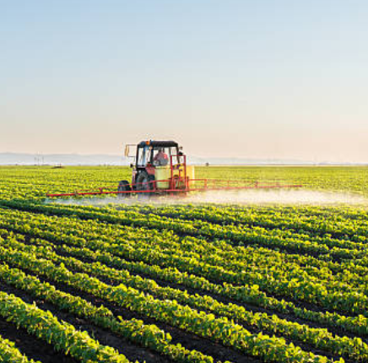
INTELLIGENT FARM OPERATIONS PLATFORM WITH SMART AGRO PRECISION SYSTEM
Mentor- Mr.Vinay Prashanth
Koushal
Madhumitha
Mohit Rathod
Naga Venkata Rama Chandram
Partheepan Sree Kavya
Yammuna
FarmVerse | Precision Agriculture Platform

Slide 2

The Problem With Traditional Farming
Manual record-keeping and scattered information cause inefficiencies.
Challenges Facing Farm Management Today
Difficult to monitor crops, irrigation, soil, and farm expenses.
Existing systems are complex, hardware-dependent, or too costly.
No simple, centralized, affordable platform for small farms.
www.reallygreatsite.com

Slide 3
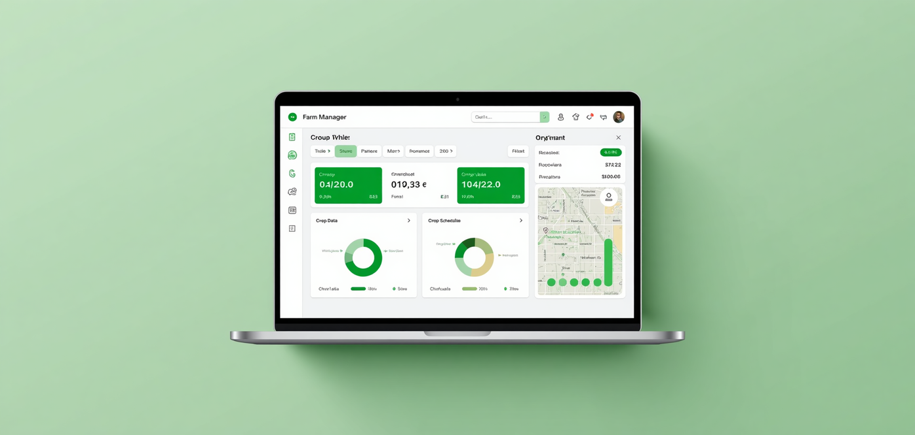
Proposed Solution
Centralized web dashboard for intuitive farm management.
Introducing FarmVerse – The Smart Answer
Digitally manage farms, crops, irrigation, soil, and weather.
No hardware sensors—uses manual and simulated data.
Affordable and user-friendly for small and medium farms.
www.farmverse.com

Slide 4
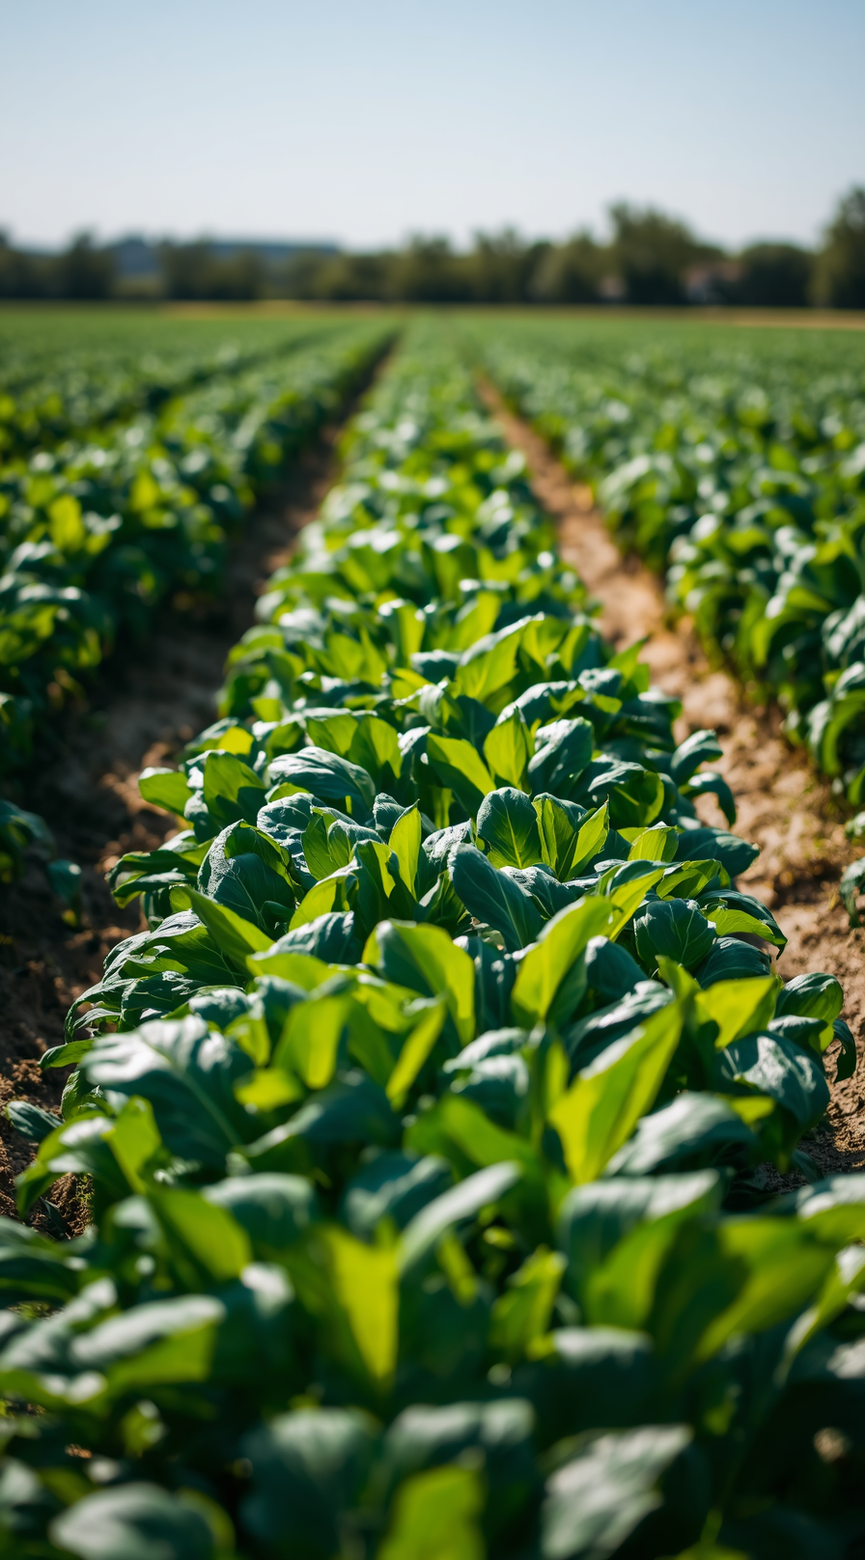
Efficiently manage farm operations via digital records and data insights.
Reduce manual paperwork and maintain digital farm records.
Improve crop management and track irrigation schedules.
Generate reports, analytics, and secure multi-user role support.
Primary & Secondary Goals
Objectives

Slide 5
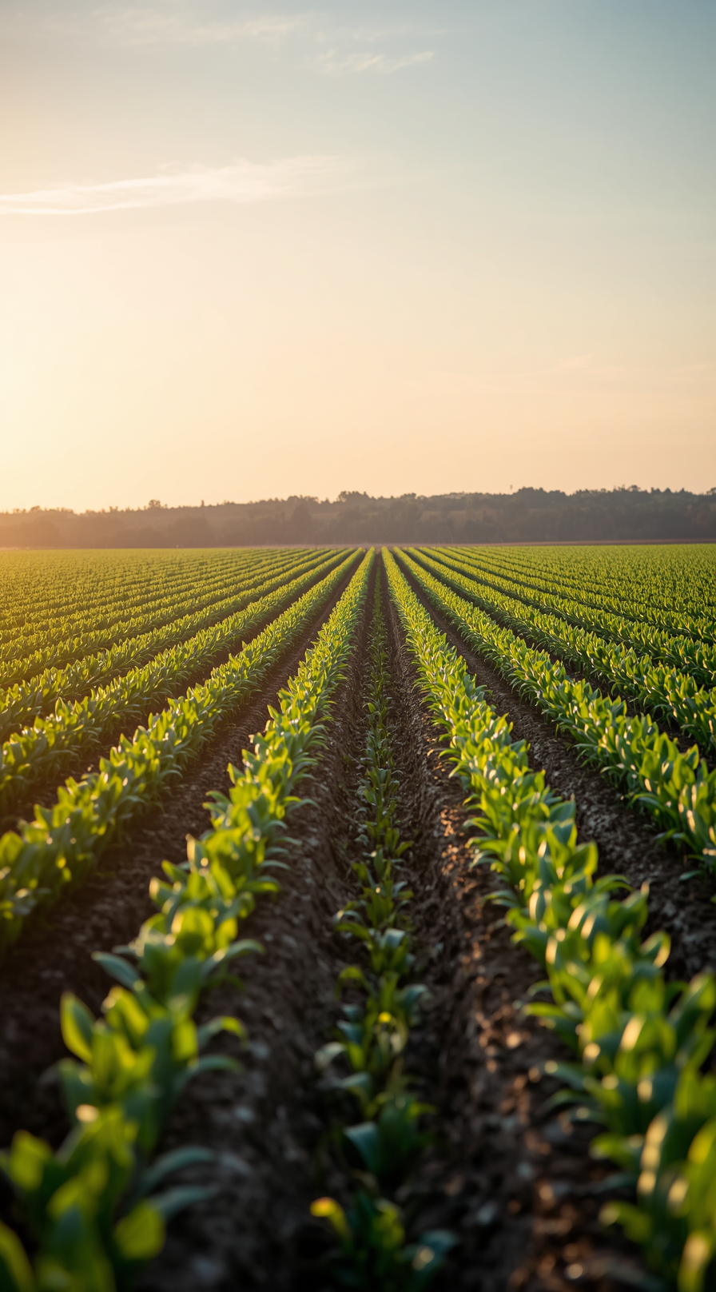
Scope of the Project
What FarmVerse Covers
Includes: User Registration, Login & Farmer Dashboard
Includes: Farm, Crop & Soil Management
Includes: Irrigation Scheduling, Weather & Notifications
Excludes: IoT Sensors, Drones & Real-time Automation

Slide 6
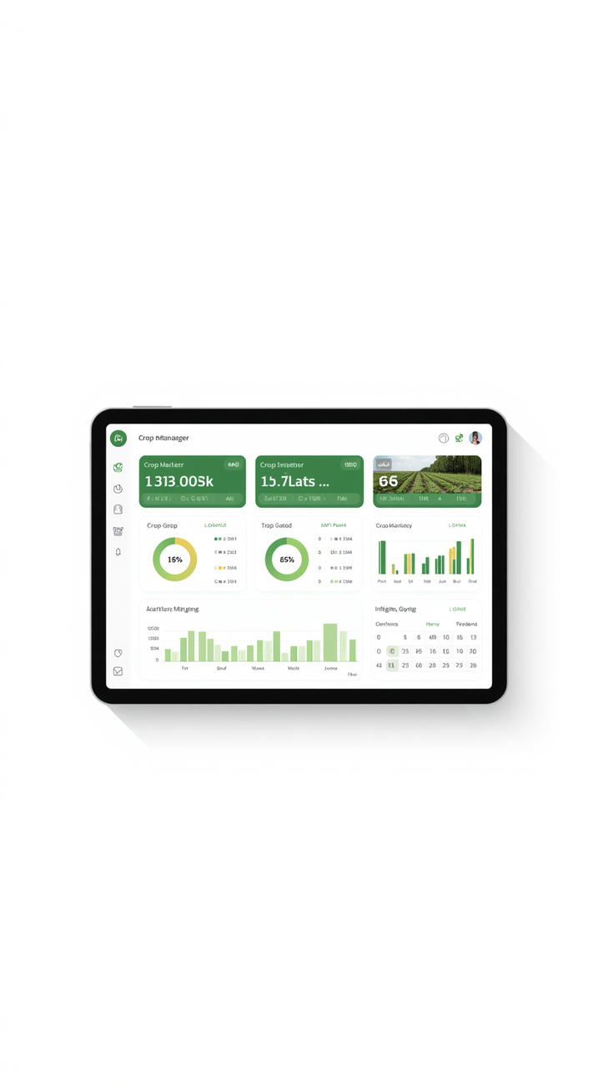
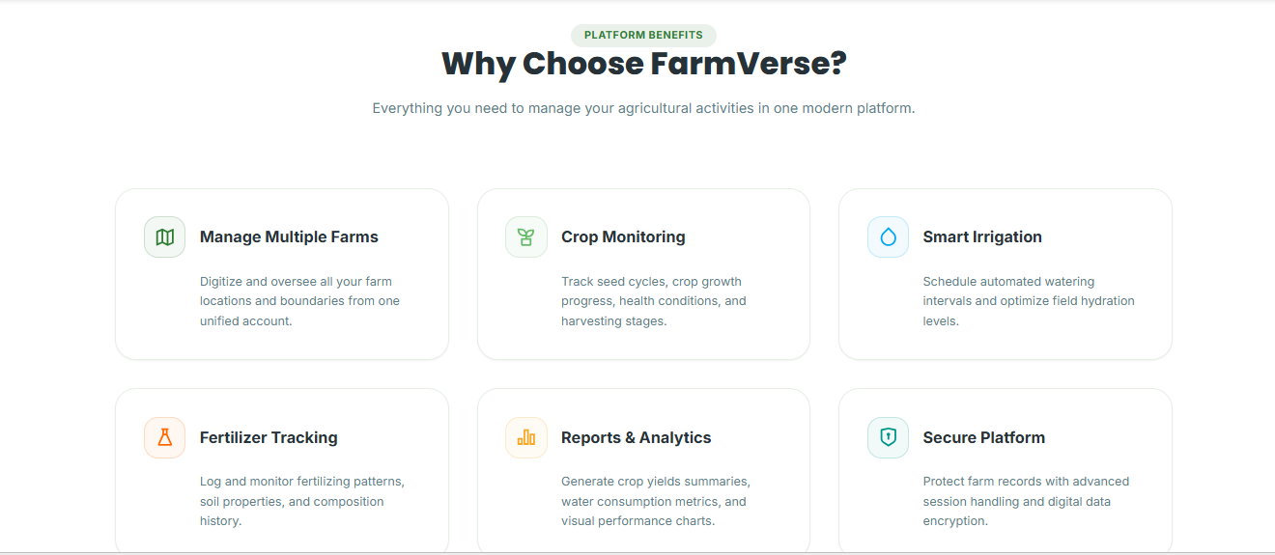
Key Features of FarmVerse
Powerful Features for Modern Farming
Digitally manage multiple farms, monitor crops from seed to harvest, schedule smart irrigation, track fertilizers, generate analytics reports, and protect your data with role-based access and encryption.

Slide 7
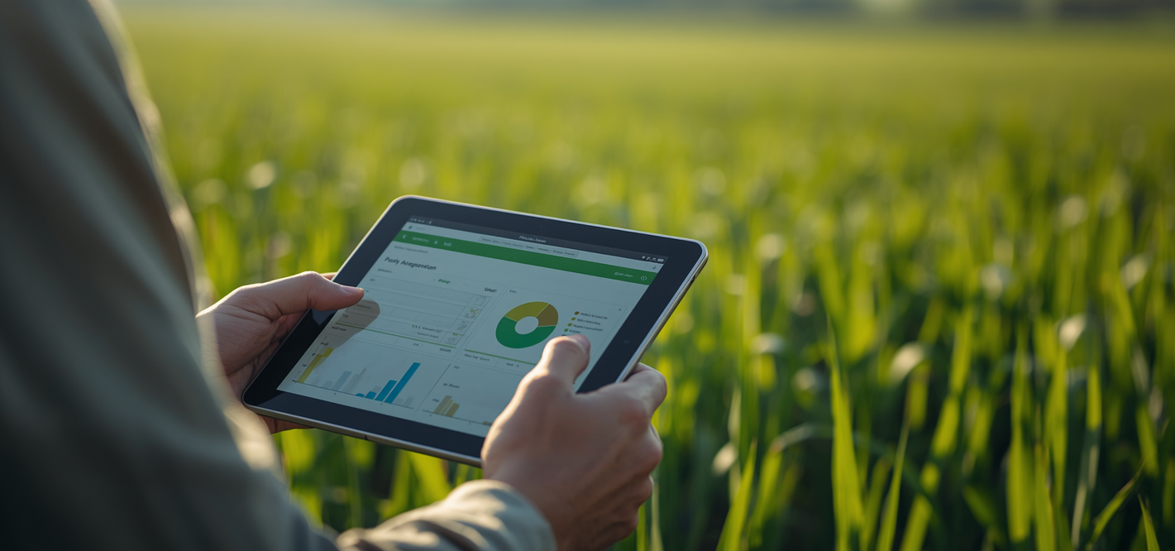
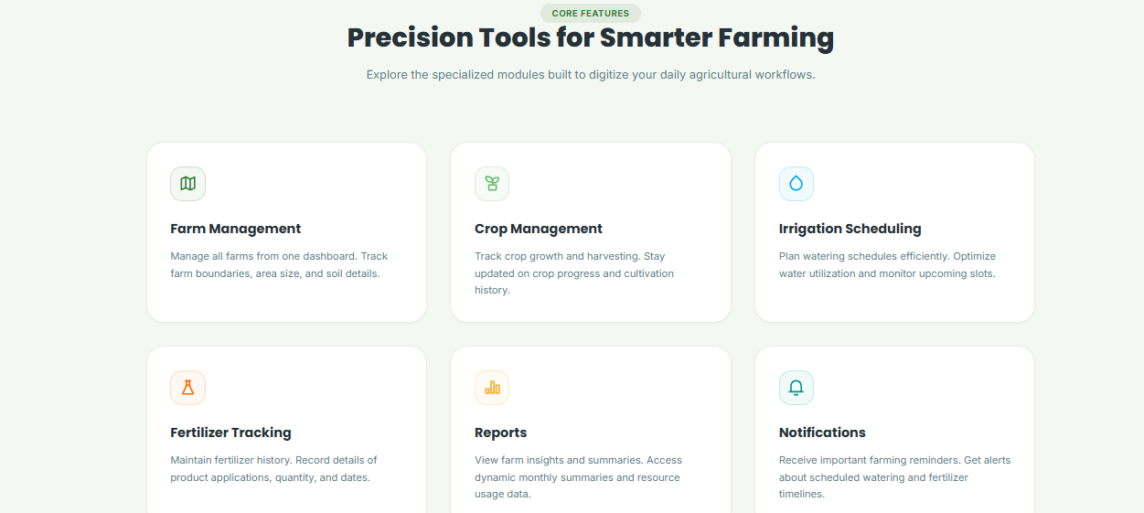
Precision Tools for Smarter Farming
Specialized Modules for Digital Workflows
Farm Management, Crop Monitoring, Irrigation Scheduling, Fertilizer Tracking, Reports & Analytics, and Smart Notifications — all in one unified platform.

Slide 8
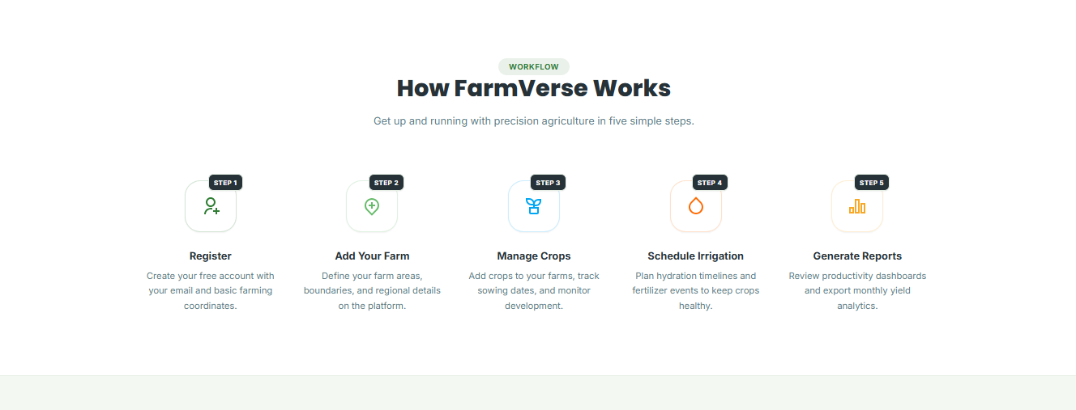
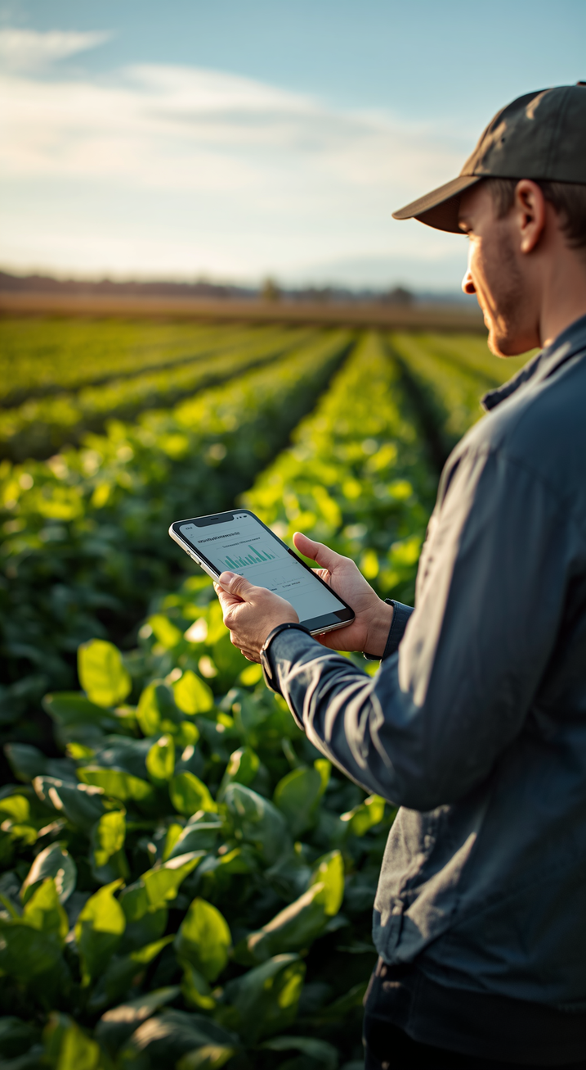
How FarmVerse Works – 5 Simple Steps
From Registration to Reports in Minutes
Step 1: Register – Create your account and enter basic details
Step 2: Add Your Farm – Define farm boundaries and location data
Step 3: Manage Crops – Add crops, planting and watering plans
Step 4: Schedule Irrigation – Plan watering and fertilizer events
Step 5: Generate Reports – View crop performance and resource analytics

Slide 9
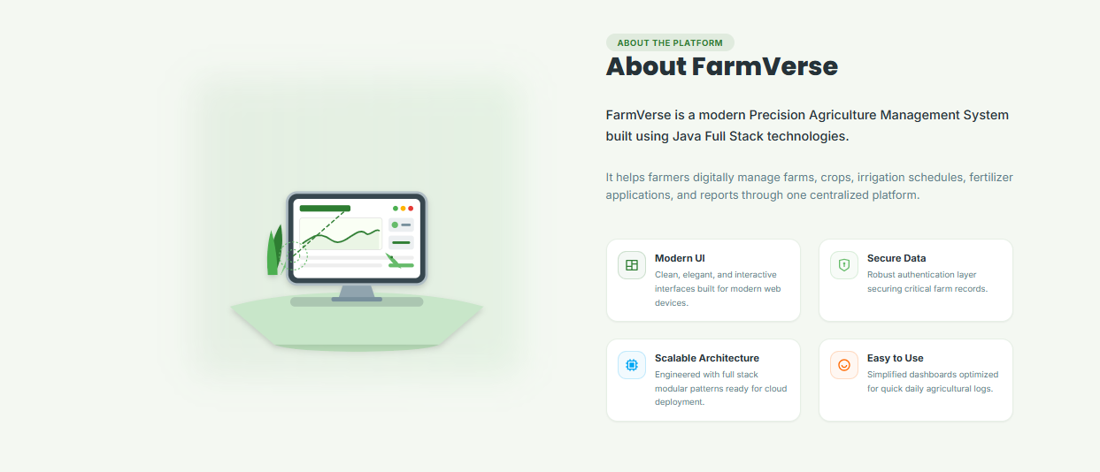
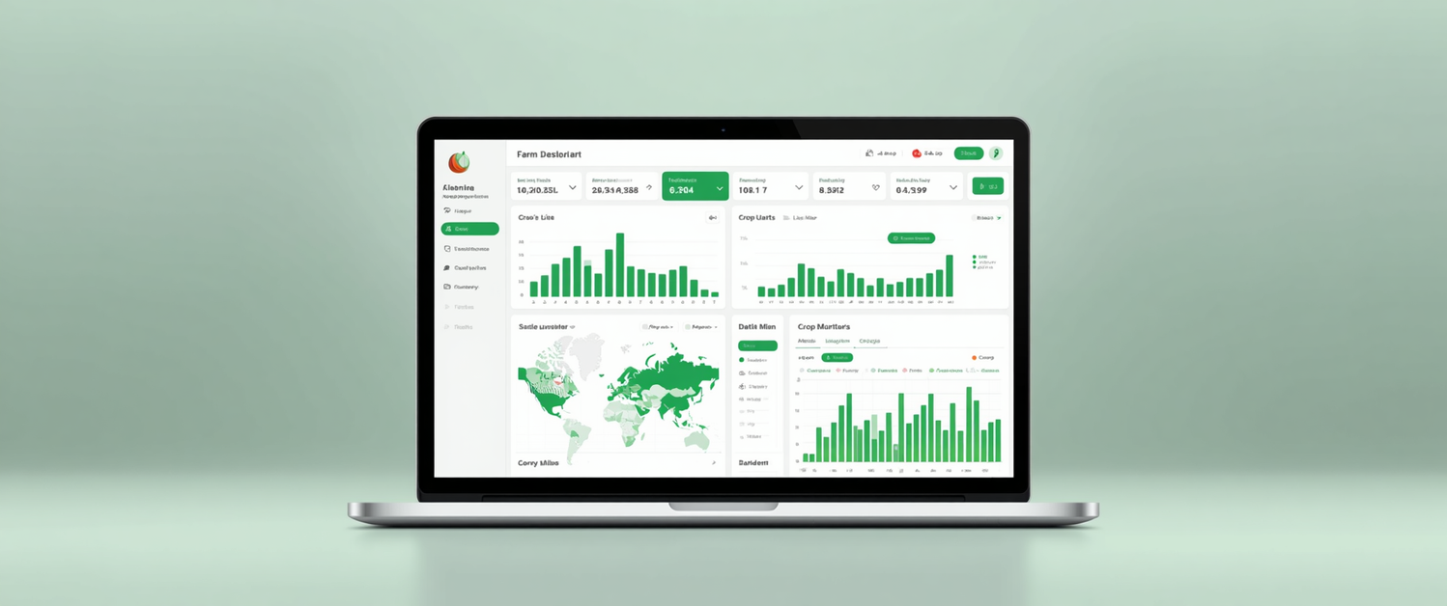
About FarmVerse Platform
Technical & Design Overview
Built on Java Full Stack for scalability. Modern, responsive UI for all web devices. Role-based access control with data encryption. Modular, cloud-ready architecture. Simplified dashboard for daily farm operations.

Slide 10
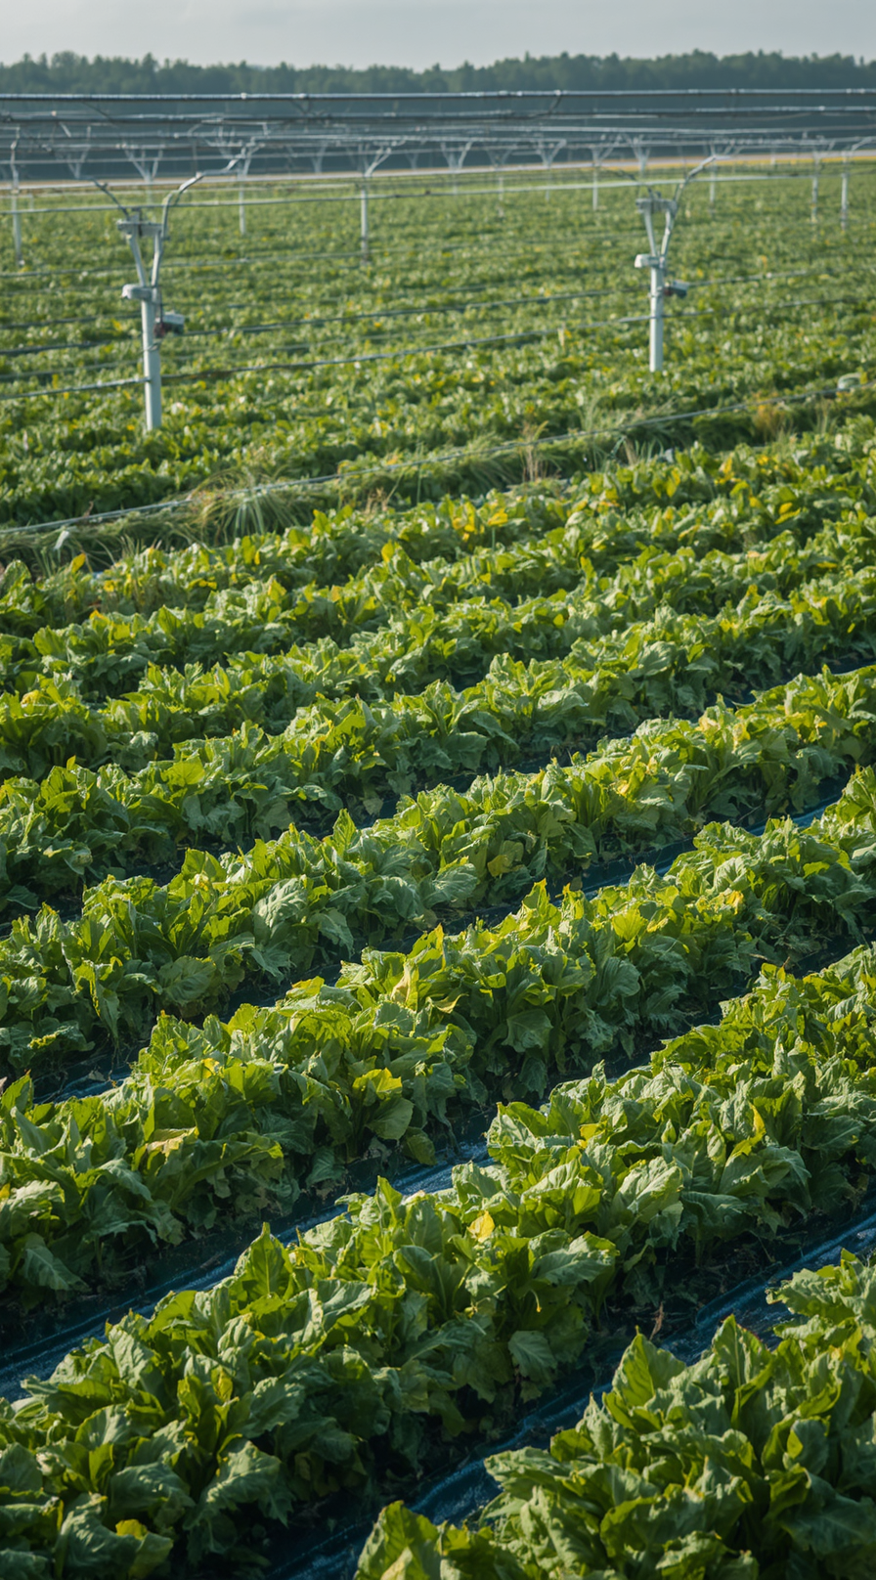
User Management: registration, login, logout, password recovery & role management.
Farm & Crop Management: add, edit, delete farms; manage crops & harvest history.
Soil & Irrigation: soil records management; plan, update & view watering schedules.
Weather & Reports: current conditions, crop reports, water usage & activity logs.
Functional Requirements
Key System
Capabilities

Slide 11
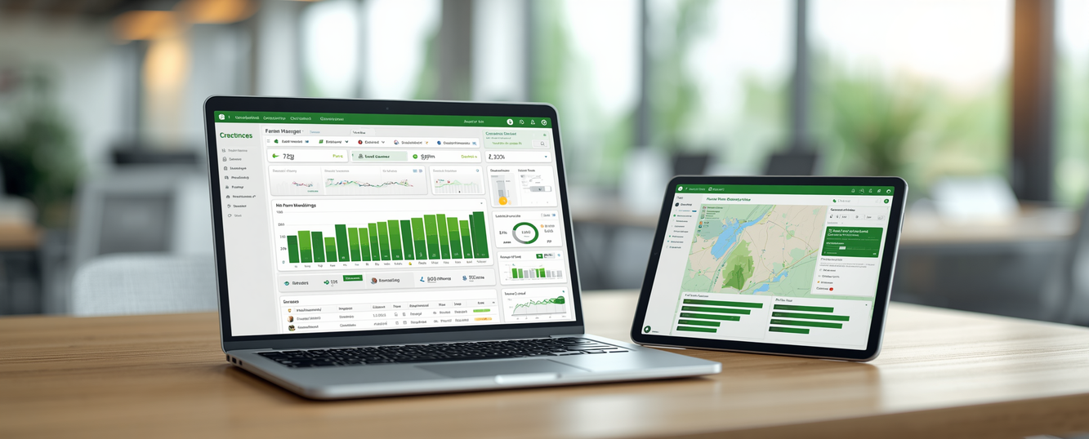
Quality & Design Principles
Non-Functional Requirements
Responsive design for all devices and screen sizes.
Secure authentication and data integrity protection.
Fast performance and scalable system architecture.
Role-based access control for secure multi-user management.
www.reallygreatsite.com

Slide 12
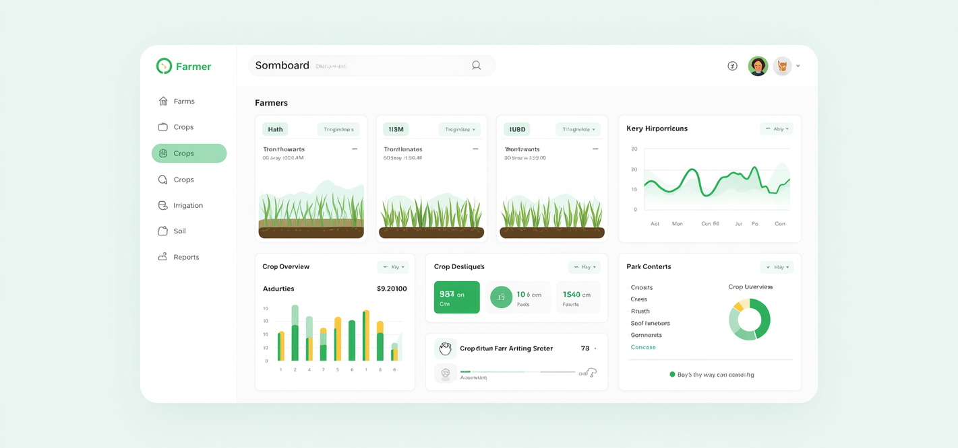
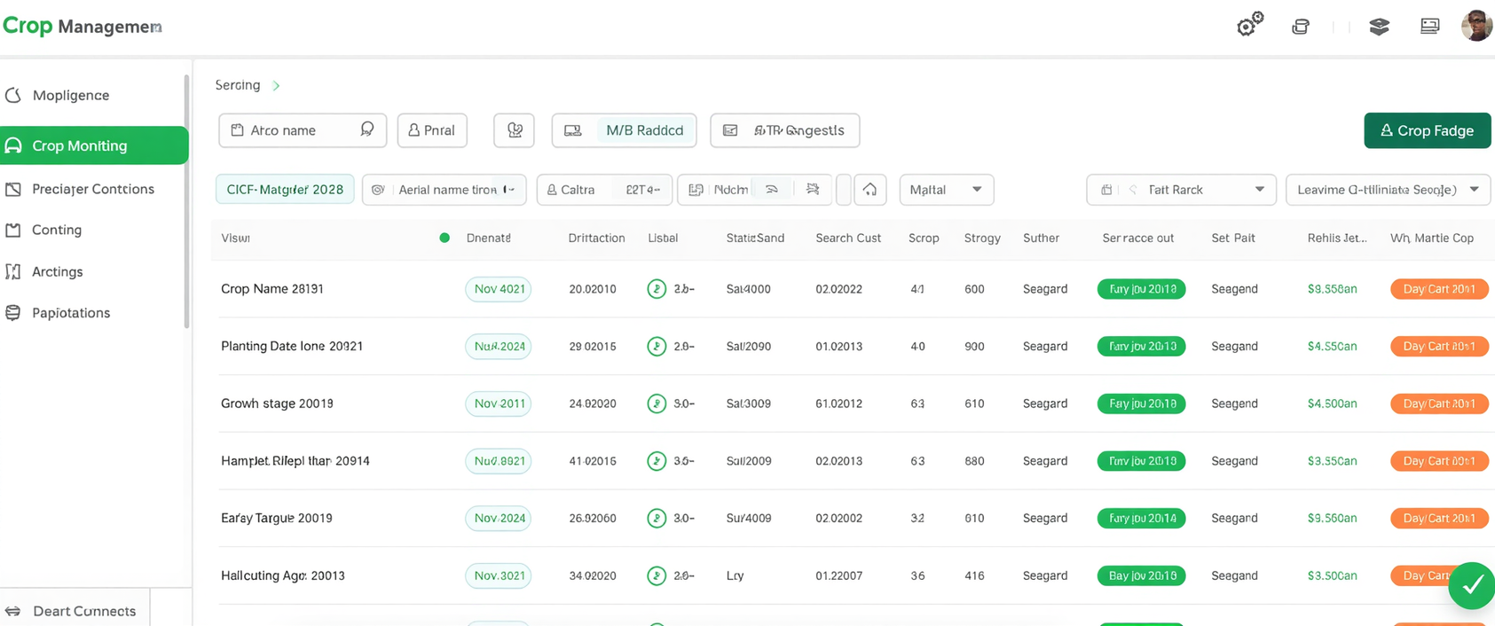
FarmVerse User Interface Preview
Clean, Intuitive & Modern Design
A visual overview of FarmVerse dashboards and modules — designed for clarity, ease of use, and seamless farm management workflows.

Slide 13
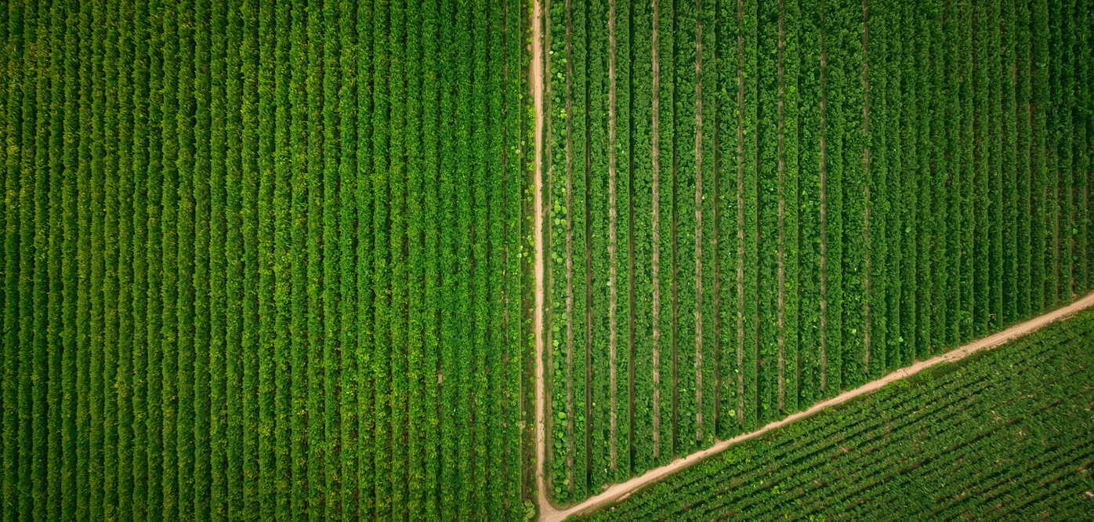
Summary of Benefits
Affordable, sensor-free precision agriculture management.
Why FarmVerse Matters
Centralized digital records improve farm operational efficiency.
Data-driven insights support better decision-making.
Supports multiple farms and user roles seamlessly.
www.farmverse.com

Slide 14
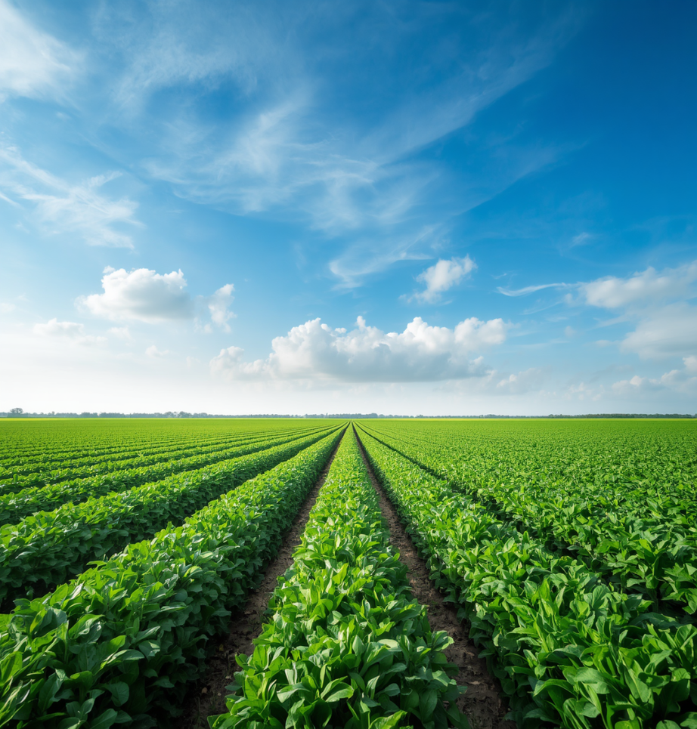
Thank You
For Your Time!
Questions? Let's Connect
farmverse@demo.com

